Slide 1
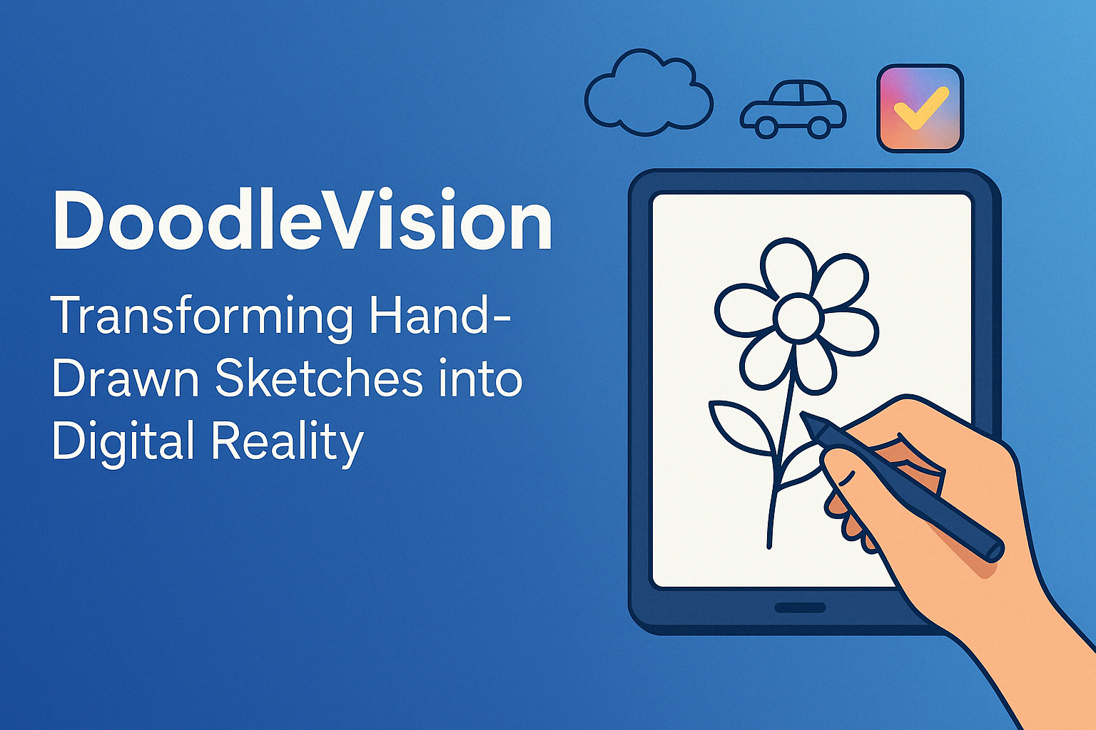
CS776 Project by Team: God's Eye
Member Name | Roll Number
Aryan Agarwal | 241110012
Keshav Banka | 241110032
Himalaya Kaushik | 241110029
Yuvraj Raghuvanshi | 241110084
Tsewang Namgail | 241110093
Tsewang Chukey | 241110092

Slide 2

Outline of Presentation
Welcome to the Doodle SketchBoard of our DoodleVision!
Project Overview
Methodologies Used, Results and Ablation studies
Comparative Analysis
Project Demo
Industry Use Cases
Team Contributions

Slide 3

Project Brief
Real-Time Interactive Sketch Recognition: Our project focuses on developing a system where users can draw objects by hand, and the deep learning model predicts the object in real-time.
Comparative Analysis and Ablation Studies: We conduct comparative analysis and ablation studies to evaluate different deep learning architectures on sketch recognition tasks.
Model Optimization for Speed and Accuracy: We aimed to optimize the prediction process by fine-tuning the model's speed and accuracy, using advanced techniques. This ensures low-latency predictions, making it suitable for real-time applications (especially for Small Devices like Mobiles)
https://www.shutterstock.com/search/arm-bowl?image_type=illustration&page=3

Slide 4
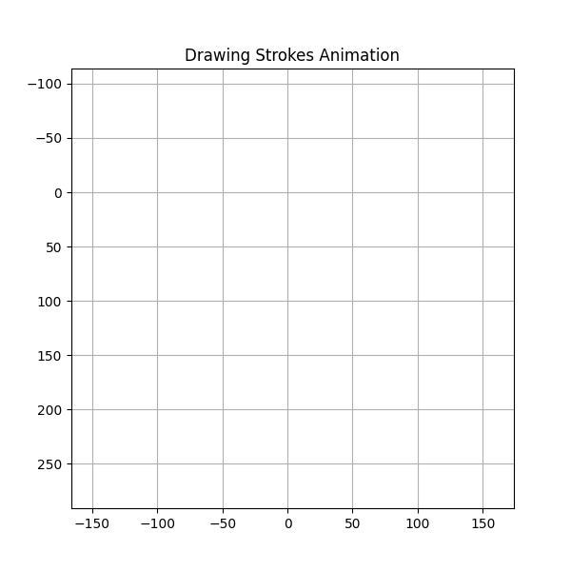
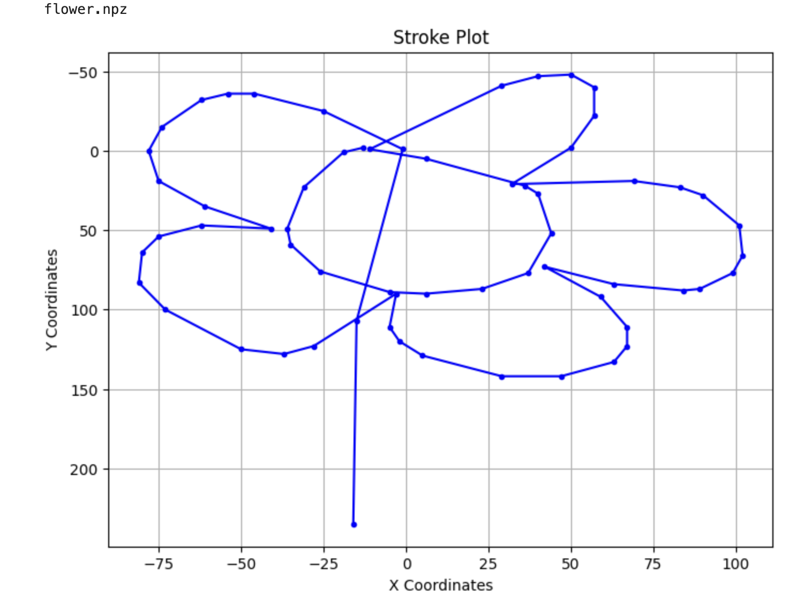


LSTM Model (Strokes Data)
LSTM (Long Short-Term Memory) is a RNN designed to learn sequences and retain long-term dependencies.
In stroke data, each sketch is a sequence of pen movements (x, y, pen status over time).
By processing strokes step-by-step, LSTM can remember important patterns (like loops, angles, or pauses) over time.
Masking → LSTM → Dense → Dropout → Dense (SoftMax)
Key Challenges Included Replicating the strokes data collection at inference. , and processing it for model to predict
Other Challenges were capturing long term memory retention in RNNs, and hence optimised LSTM layers.
Used 20K samples per class to train the model
Training Data Processed from Strokes Dataset
Inference Data Processed from Strokes at realtime
Training Data Strokes plotted in each timestep: Flower and Ice cream Examples

Slide 5
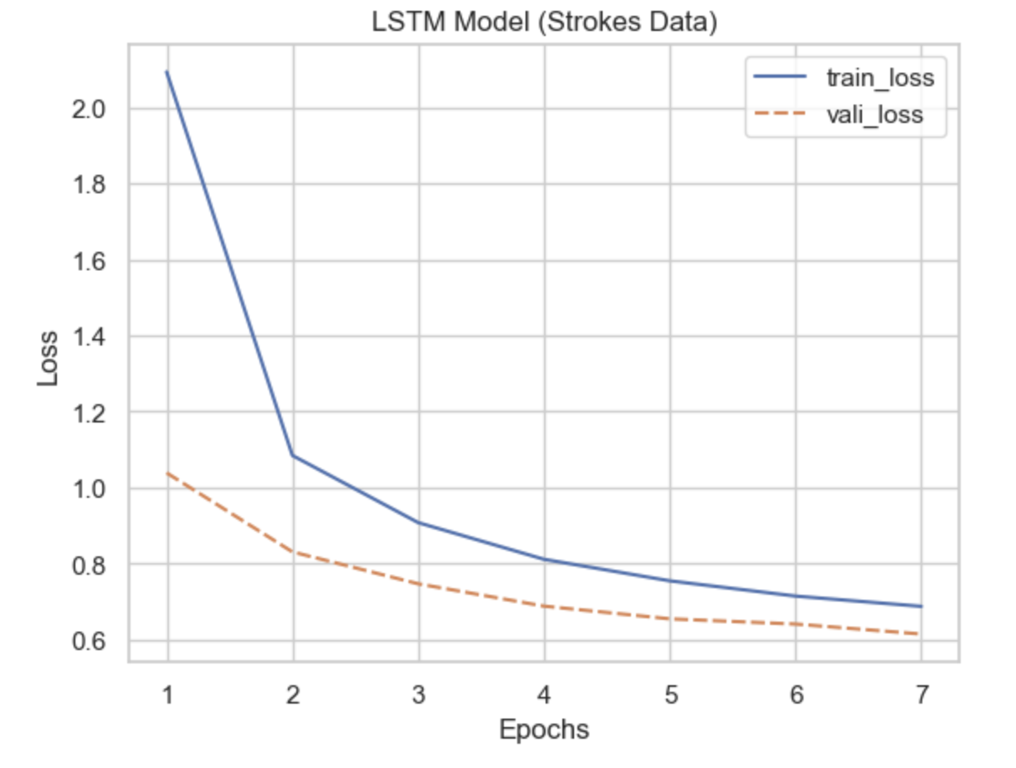
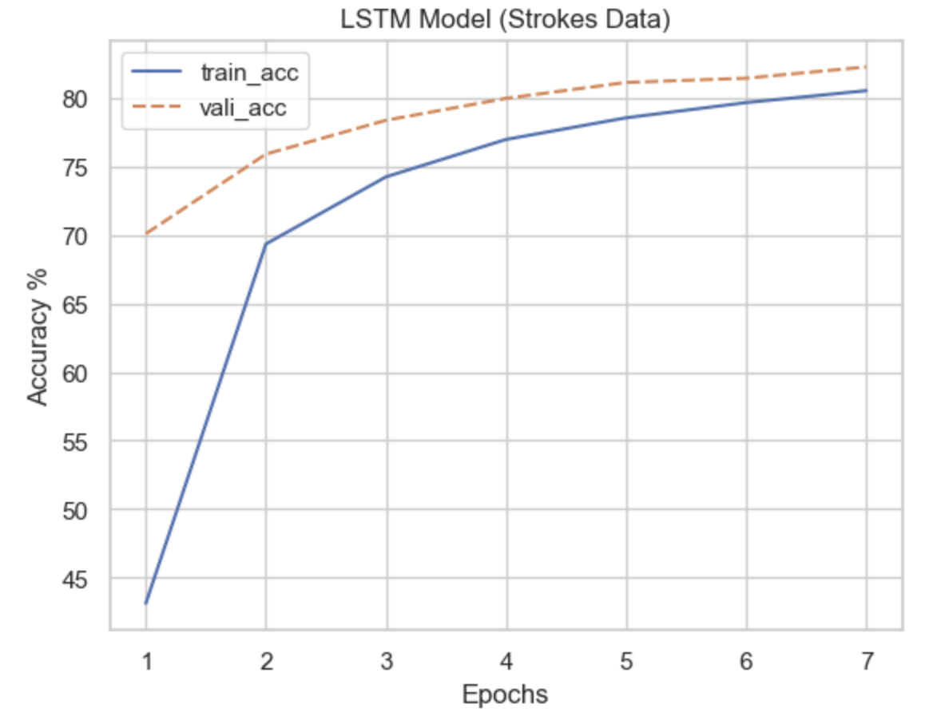
LSTM Model (Strokes Data)
Trained the model on Strokes data, and results reflect accuracy saturating after 5 epochs.
LSTM are good for these datasets as they are faster to train than its counterpart ConvLSTM, and faster at inference as well with lesser number of parameters.
Research Paper Comparison: SketchFormer by Parihar et al (2020) got 83.98% for RNN based models for similar dataset.
Number of Parameters: 395288 and Total Size of Model : 1.51 MB and Test Dataset Accuracy 81.93% and Loss 0.6170
Please note we are showcasing final results.
Training Results: Accuracy Values and Loss Values over epochs

Slide 6
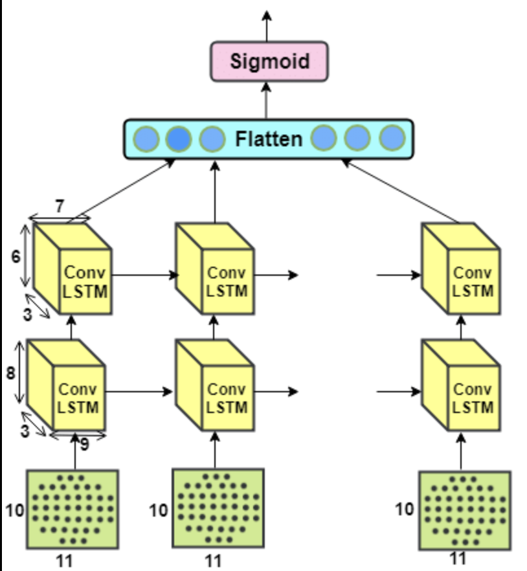
ConvLSTM Model (For Strokes Data)
ConvLSTM (Convolutional Long Short-Term Memory) extends LSTM by integrating convolutional operations, allowing it to capture both spatial and temporal dependencies in sequential data.
By processing strokes as sequences of image-like patches, ConvLSTM learns spatially-aware motion patterns (e.g., shape build-up, stroke overlaps).
ConvLSTM is well-suited for these datasets when spatial patterns within stroke sequences matter more, though training is slower and heavier than standard LSTM due to higher complexity.
Reshape → ConvLSTM → Flatten → Dense → Dropout → Dense (Softmax)
https://www.researchgate.net/figure/Model-2-Architecture-of-ConvLstm_fig3_328848867

Slide 7
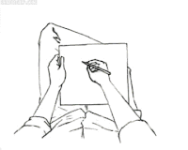
ConvLSTM Model (For Strokes Data)
Key Challenges included transforming stroke data into 2D temporal frames suitable for ConvLSTM, while preserving stroke sequence order. And Heavy Training time (27 mins per epoch with GPUs and Slower at Inference than LSTM)
Other challenges involved managing longer training times, GPU memory constraints, and tuning convolutional kernel sizes for optimal pattern recognition.
Number of Parameters: 798,904 ; Test Dataset Accuracy: 87.43%
Research Paper Comparison: Deep Learning Assister depth estimation... by Faseeh et al did not use ConvLSTM for classification task but used for object depth estimation. We enhanced its capability for object classification tasks.
Conclusion: For given dataset problem, it's best to stick with LSTM with faster training as good Accuracy can be attained with less parameters here

Slide 8
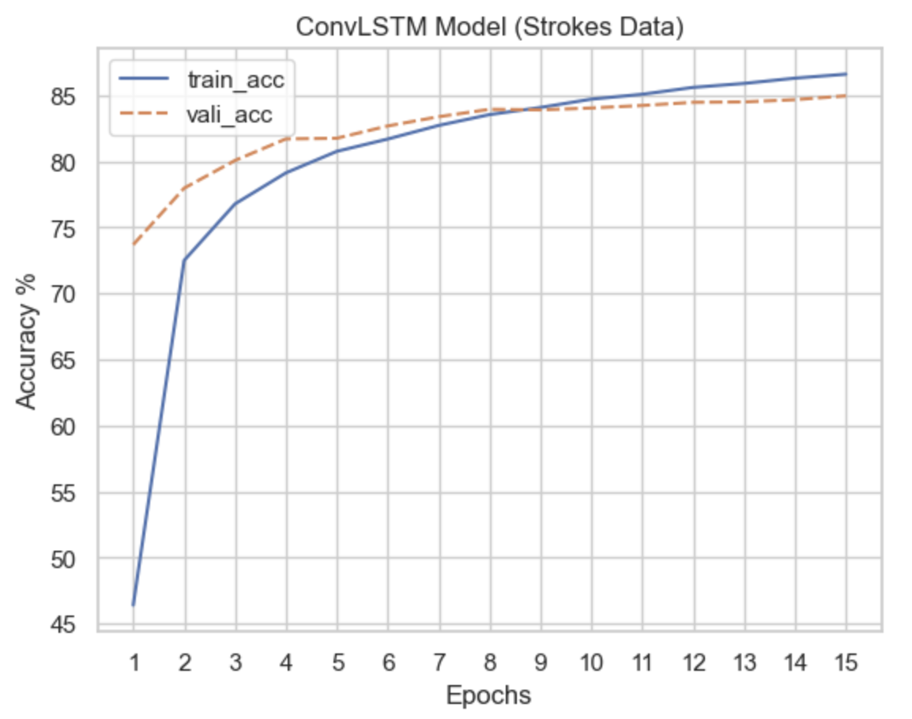
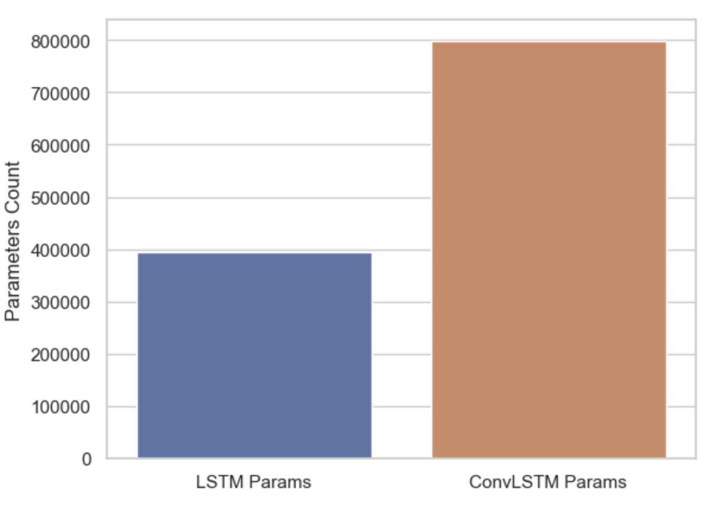
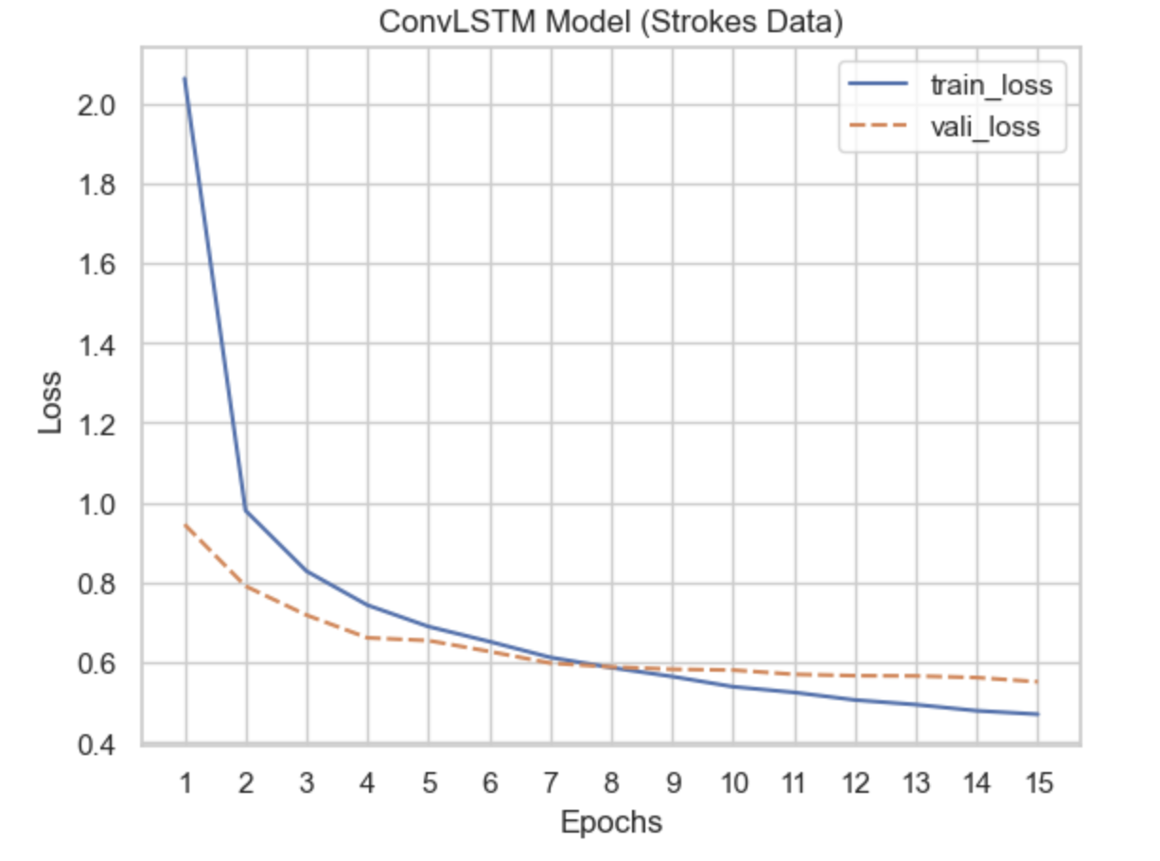
ConvLSTM Model (For Strokes Data)
Comparison Across both LSTM based Strokes Models
Training Results: Accuracy Values and Loss Values over epochs

Slide 9
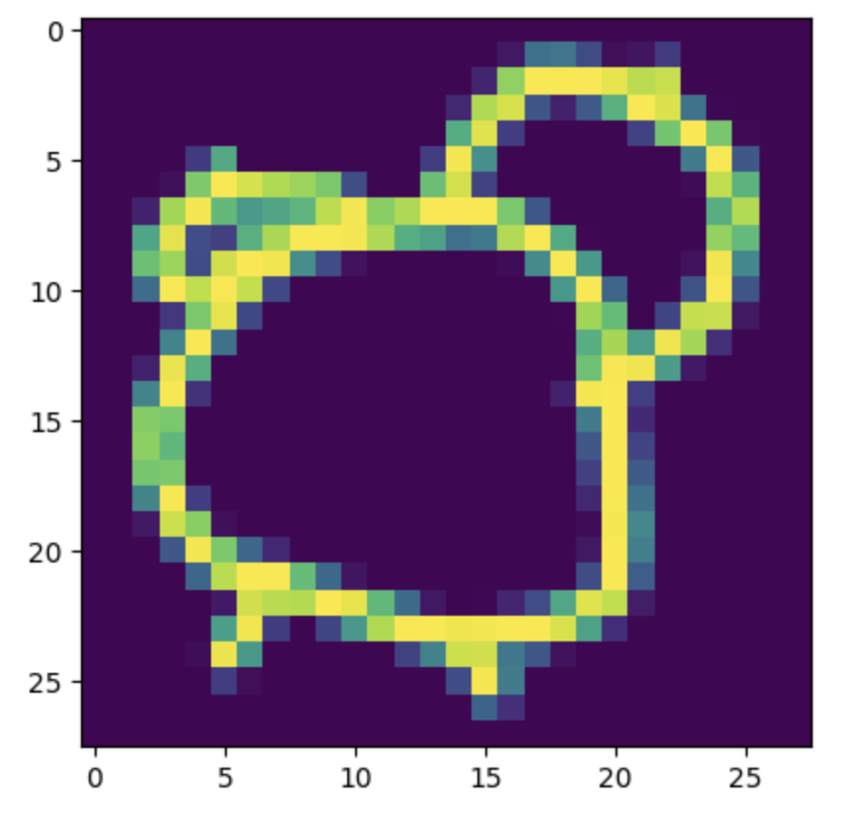
Vision Transformer (Image Data)
Vision Transformer (ViT) applies Transformer architecture to image data by splitting images into patches and treating them as a sequence, enabling global context learning without convolutions.
In this model, grayscale images (28×28) are split into patches (4×4) hyperparameter tuned, each of which is linearly embedded into a vector. The Transformer layers then process this sequence to learn spatial relationships and features.
ViT is effective for small grayscale image data with proper patching and embedding. It requires more compute than LSTM, but it learns better global features due to self-attention.
Patch → Embedding → Positional Encoding → Transformer Encoder × N → Global Pool → MLP → SoftMax

Slide 10
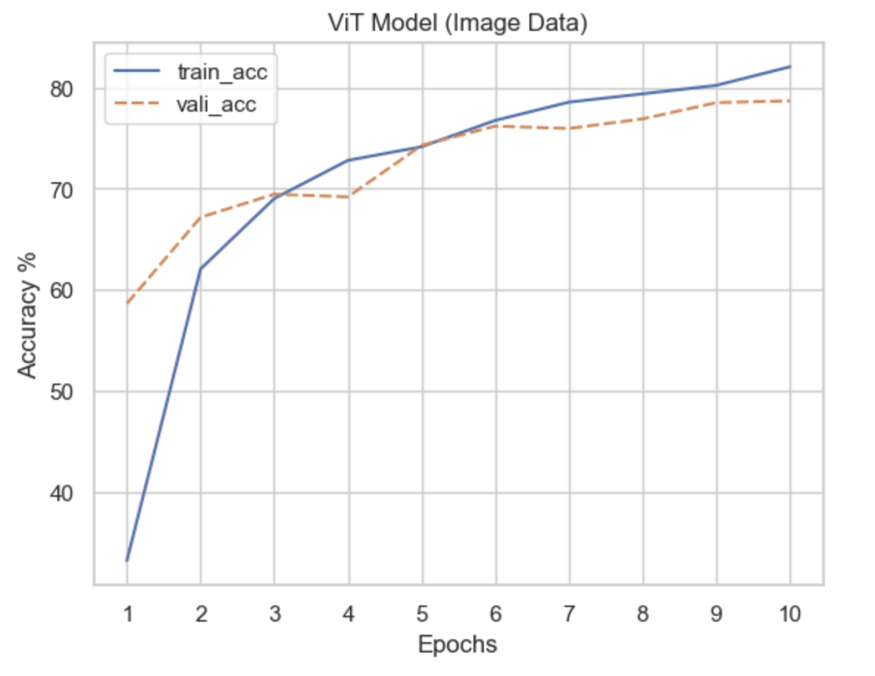
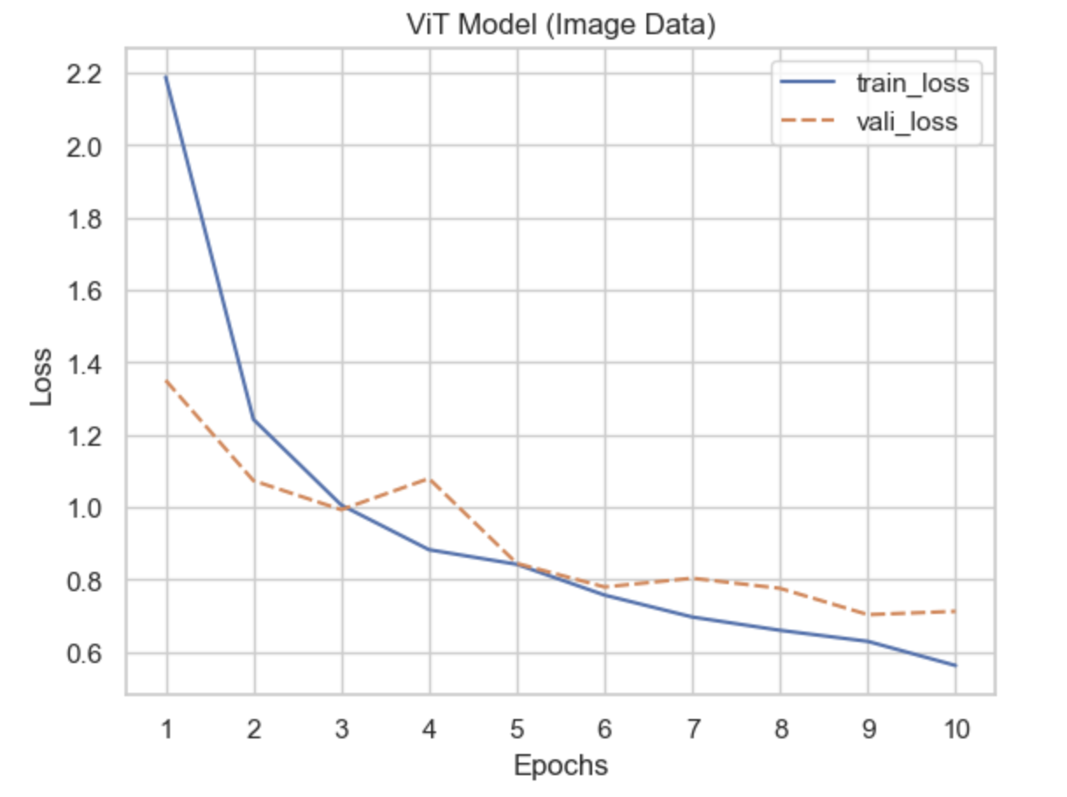
Vision Transformer (Image Data)
Trained the model on image data (not stroke sequences). The ViT showed steady accuracy improvement, saturating around 82 % after 10 epochs.
Number of Parameters: 7.93M, Model Size: ~30 MB, Test Accuracy: ~80.00%, Loss: 0.6960
Key Challenges included ensuring patch size balances spatial resolution and sequence length, and stabilizing training without pretrained weights, necessity of larger dataset and parallel computing resources
Other challenges were optimizing self-attention over small patch counts and preventing overfitting using dropout and GELU activations.
Research Paper Comparison: SketchFormer: Transformer-based approach for sketch recognition using vector images by Parihar et al., 2020 got 88.72% Accuracy for similar Sketch dataset
Training Results: Accuracy Values and Loss Values over epochs

Slide 11
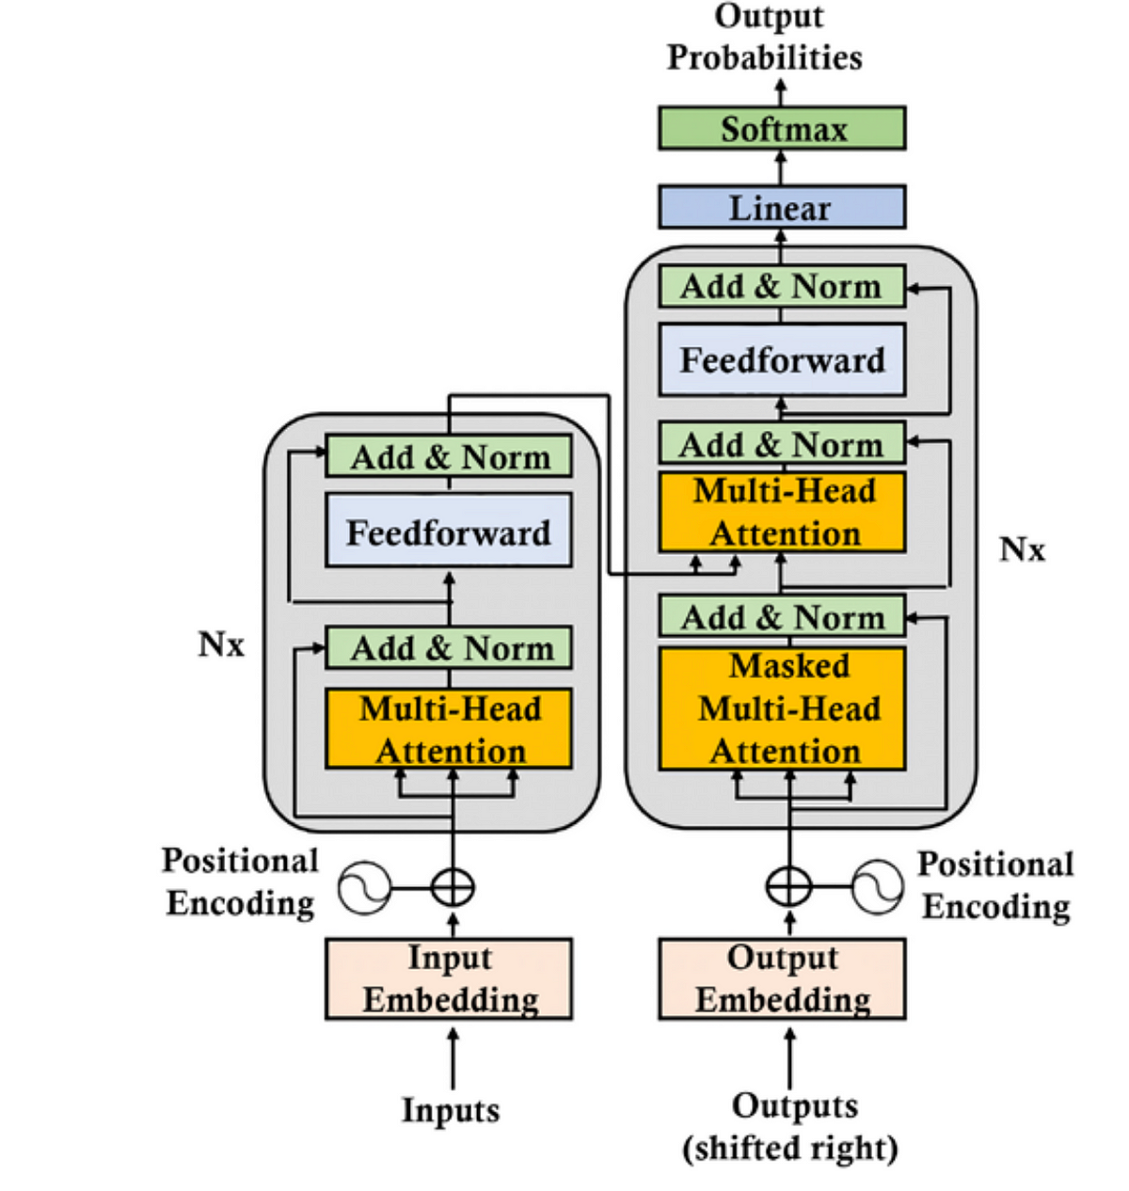
Transformer Model (For Strokes Data)
Transformer uses self-attention to model long-range dependencies in stroke sequences (Δx, Δy, pen state).
Each stroke sequence is padded to 130 steps and embedded with learnable positional encodings.
The model captures global context using Multi-Head Attention + Feed Forward layers.
Dense → Positional Encoding → TransformerBlock ×2 → GlobalAvgPool → Dense → Dropout → Dense (Softmax)
Used 10K samples/class, trained for 20 epochs on QuickDraw sketch dataset.
Input shape: (130, 3) per stroke sample.(padded to 130 for all the strokes data)

Slide 12
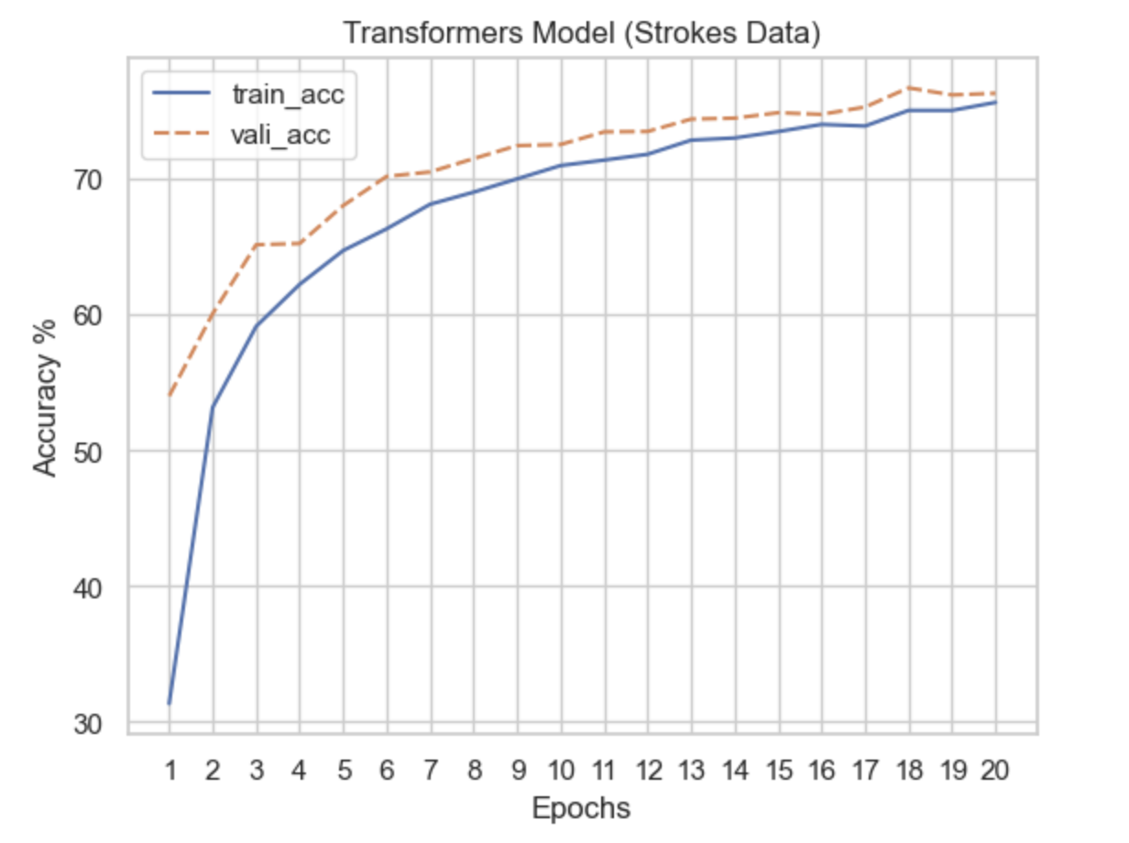
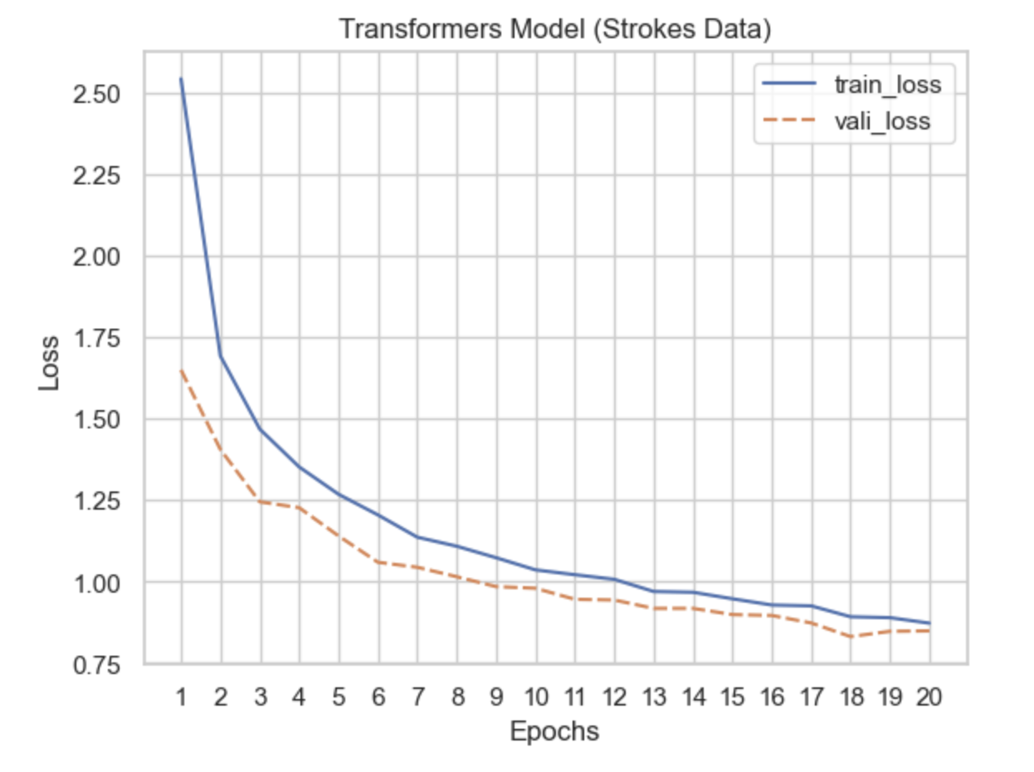
Transformer Model (For StrokesData)
Trained on stroke data, accuracy gradually improved over 20 epochs.
Final Test Accuracy: 76.29%, with decreasing validation loss trend.
Number of Parameters: ~625,000
Research Paper Comparison: “Vision Transformer for Brain Stroke Classification” (ScienceDirect 2023) used ViT for CT scans — achieved 87.51% but not stroke pen sequences.
Ablation Study Highlights:
Removing Positional Encoding ↓ accuracy by 4%
Only 1 Transformer Block ↓ accuracy by 3%
No Dropout ↑ overfitting

Slide 13
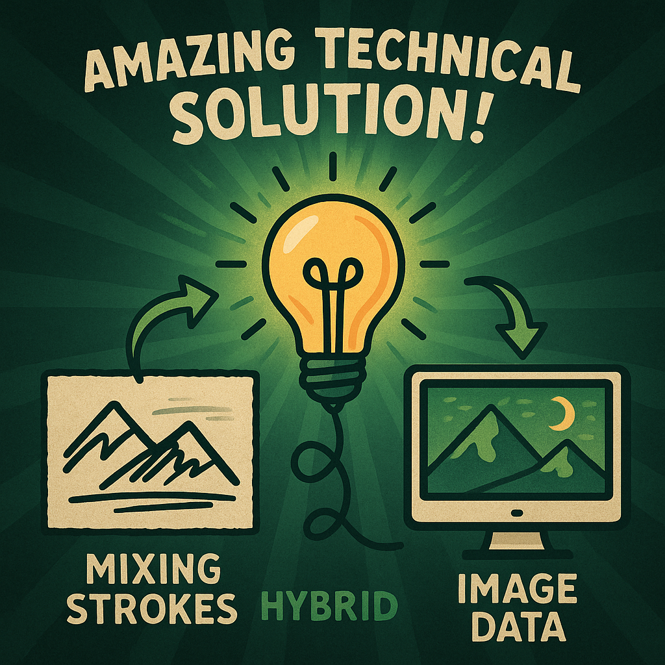

Our Novel Solution to Problem !!
Use Temporal Power of Strokes and Spatial feature capturing power of CNN!
Faster Inference due to Parallel Architecture!
Small Model so efficient for smaller devices!
Details on next Slide :)

Slide 14
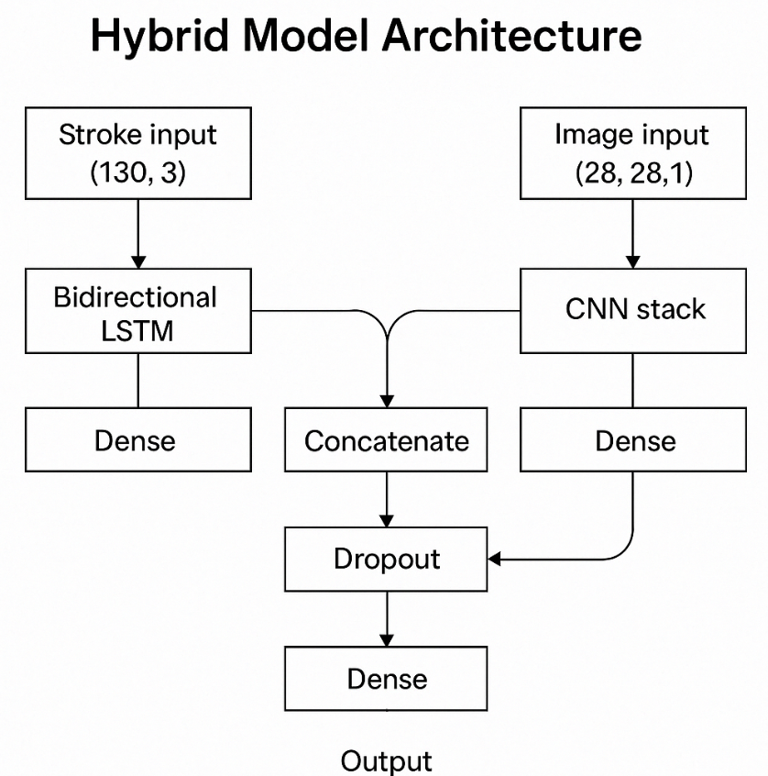
Hybrid Model (strokes + image)
The hybrid model combines stroke sequence modeling with image-based recognition for improved accuracy.
Stroke input ⁠ (Δx, Δy, pen state) ⁠ is processed using a Bidirectional LSTM for capturing temporal stroke dynamics.
The image input (28×28 grayscale) is processed via a CNN stack to extract spatial patterns.
CNN(Image) → Dense ⬌ BiLSTM(Stroke) → Dense → Concat → Dropout → Dense (Softmax) ⁠
Inputs: ⁠ (130, 3) ⁠ for strokes and ⁠ (28, 28, 1) ⁠ for images — both normalized before training.

Slide 15
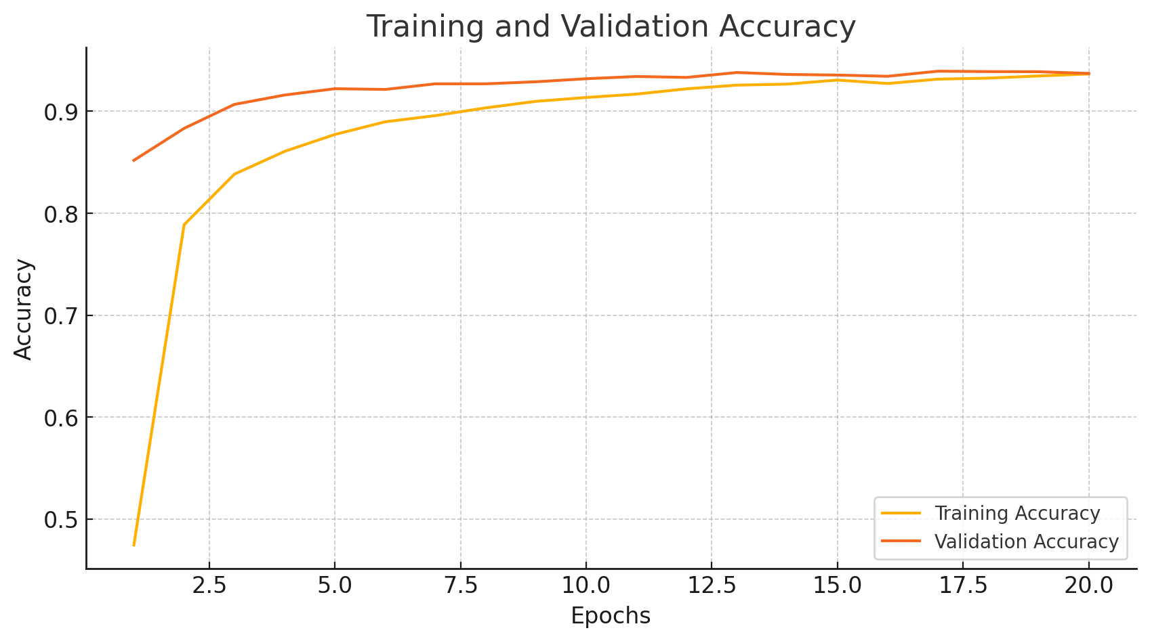
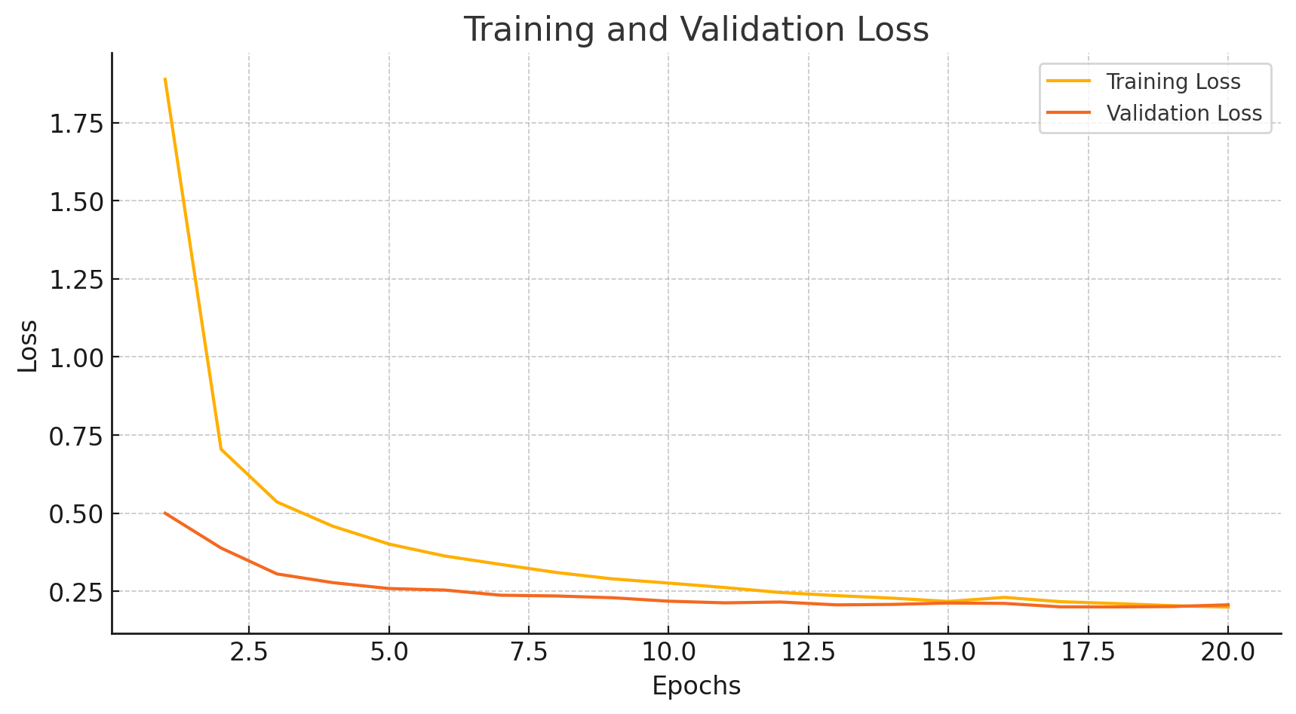
Hybrid Model (strokes + image)
Achieved 93.12% validation accuracy, using both stroke and image data.
Model Parameters: ~0.57 million | 2.21 MB size
Observation: Stroke-only or image-only input yields lower accuracy (70–82%) compared to fused input.
Comparison Insight:
Unlike traditional CNNs, combining temporal stroke info improved distinction between similar classes (e.g. cup vs bowl).
Real-Time Inference Results:
•⁠ ⁠Top-1 accuracy strong for clean, centered sketches.
•⁠ ⁠Stroke-only predictions often biased for “cup-like” classes.
•⁠ ⁠Real-time system uses Mediapipe to capture strokes & predict via webcam.

Slide 16
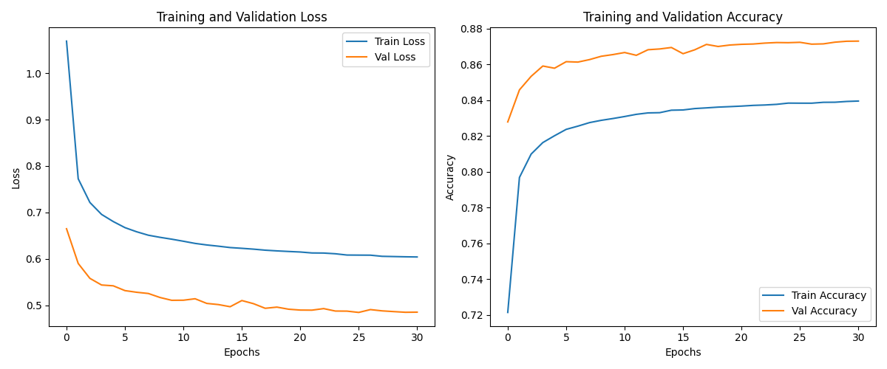
CNN Based Model
Deep learning model designed to automatically extract spatial features from images, making it ideal for classifying doodles
Used different convolutional layers and tried different combinations of CNN and MLP
Trainable params: 230,386 Size: 2.64MB
Test Accuracy : 87.2%
Research paper : Meta Analysis of Deep Learning Models for Doodle Recognition uses CNNs, but we tried deeper and more layers. Choose what worked perfectly for us.
Base model
(28×28×1) →
Conv2D(32, 3×3) → ReLU → MaxPool(2×2) → BatchNorm →
Conv2D(64, 3×3) → ReLU → MaxPool(2×2) → BatchNorm →
Flatten() → Dropout(0.4) →
Dense(128) → ReLU → Dropout(0.2) →
Dense(345) → Softmax

Slide 17
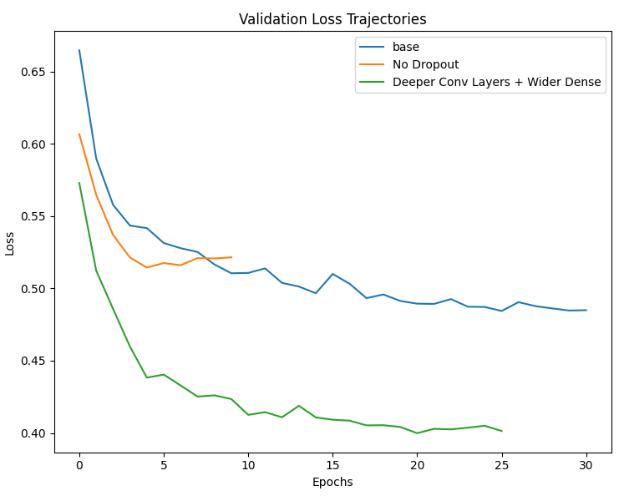
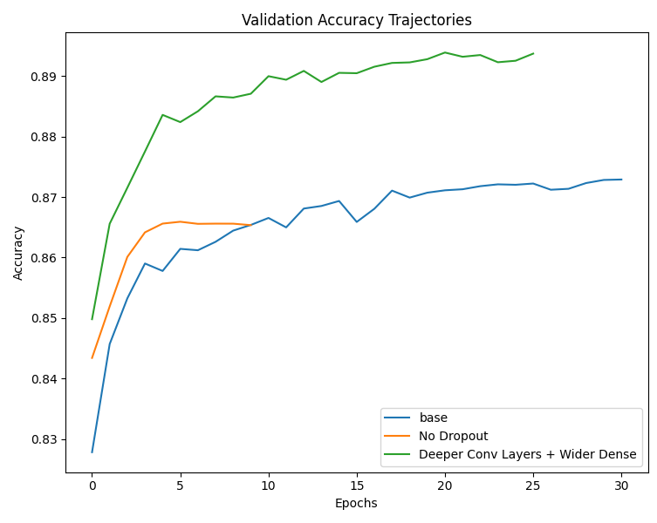
Ablation study on CNN
Tried different techniques, different layers were added & removed to test their effect on the accuracy and training time.
Quick plateau without dropout -> Early stopping
Difference in accuracy and time in base and deeper model
Model Variant | Conv Layers | Dense Layer(s) | Dropout | Changes Made | Param Count | Val Acc | Model Size
Base Model | Conv(32, 3) → Conv(64, 3) | Dense(128) | 0.4 + 0.2 | – | 230,386 | 87.24% | 2.64MB
No Drop | Conv(32, 3) → Conv(64, 3) | Dense(128) | None | Removed both Dropout layers | 230,386 | 86.54% | 2.64MB
Deeper Model | Conv(64, 5) → Conv(128, 3) | Dense(256) | 0.4 + 0.2 | More filters larger kernels bigger dense layer | 908,210 | 89.41% | 10.4MB
Ablation Study Highlights:​
No Dropout increased overfitting and triggered early stopping
Deeper model increased accuracy but increased param count & model size disproportionately

Slide 18
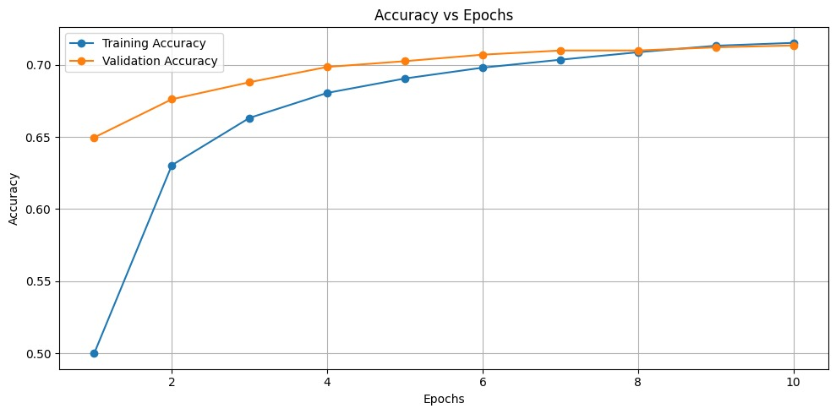
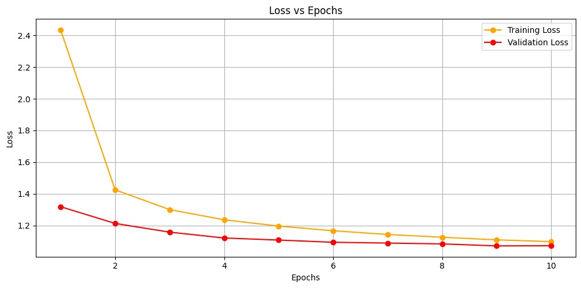
InceptionV3 Model
Inception V3 ("Extreme Inception") was published in 2017.
It is a linear stack of depth-wise separable convolution layers with residual connections.
Test Accuracy: 86.3%
Total params: 22,077,176 (84.22 MB)
Trainable params: 274,328 (1.05 MB)
Non-trainable params: 21,802,848 (83.17 MB)
Paper Meta Analysis of Deep Learning Models for Doodle Recognition didn’t try Inception Net and used only 25 classes so, tried this.

Slide 19
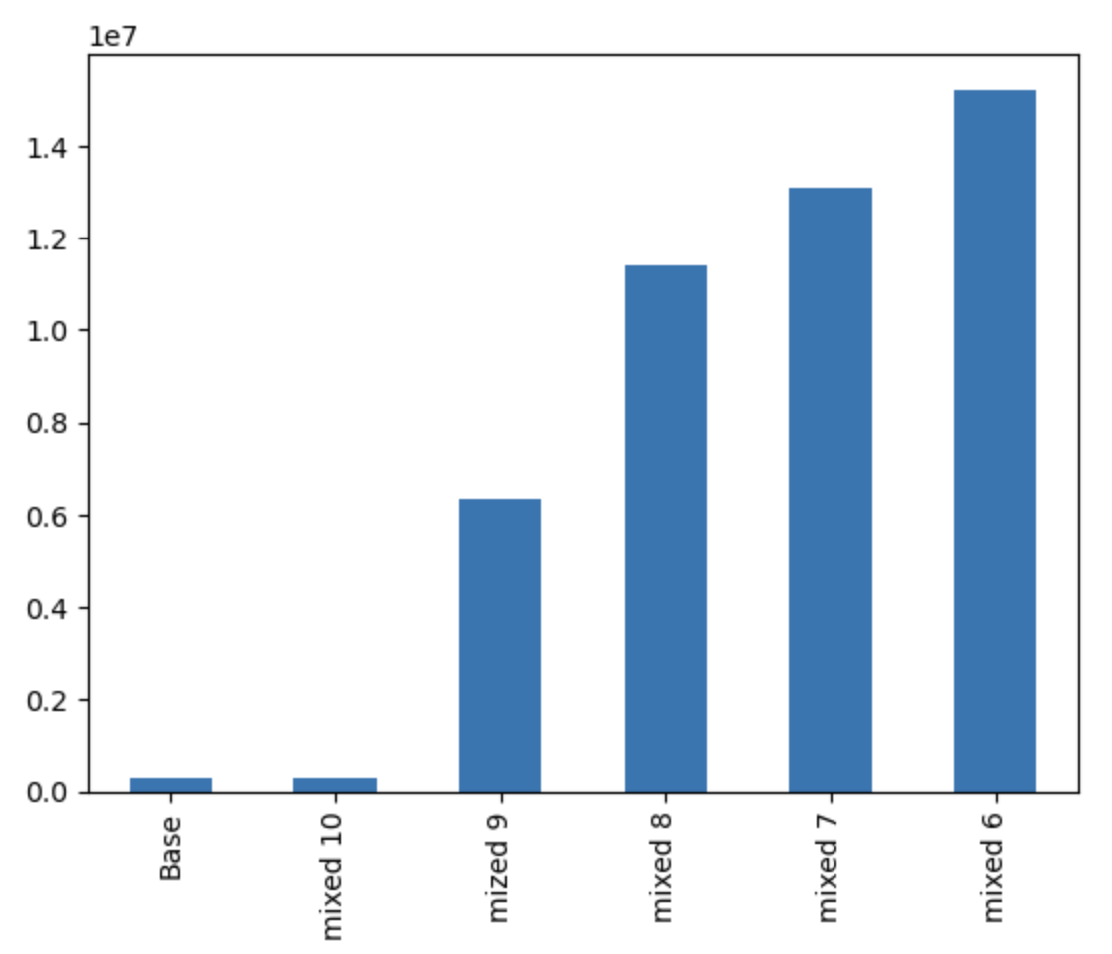
InceptionV3 Model Ablation Study
Base: Fine-tuning only the classification head gives modest accuracy improvements with higher loss.
Params: 284063
mixed10: Unfreezing mixed10 slightly boosts performance but gains are limited.
Params: 284063
mixed9: Unfreezing mixed9 gives noticeable improvement in both accuracy and loss.
Params: 6357599
mixed8: Further unfreezing to mixed8 significantly improves generalization and model performance.
Params: 11398943
mixed7: Unfreezing mixed7 provides strong accuracy and lower loss, showing effective feature adaptation.
Params: 13095967
mixed6: Unfreezing from mixed6 gives the best overall performance, balancing high accuracy and low loss.
Params: 15235999

Slide 20
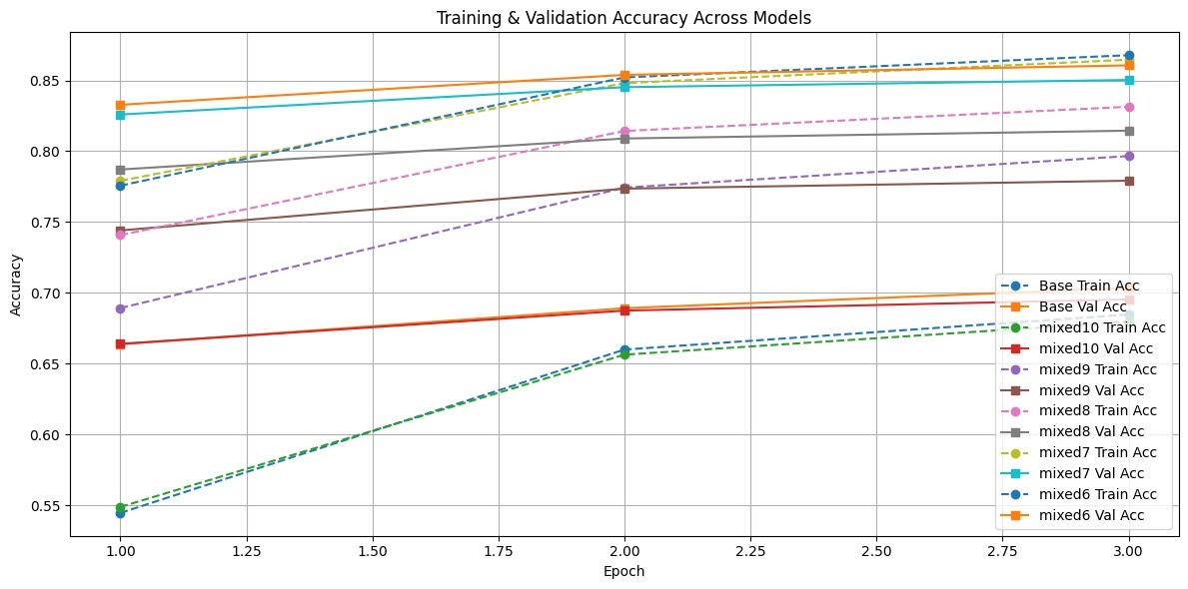
InceptionV3 Model Ablation Study

Slide 21
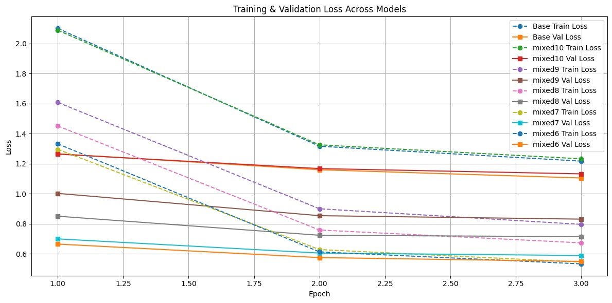
InceptionV3 Model Ablation Study

Slide 22
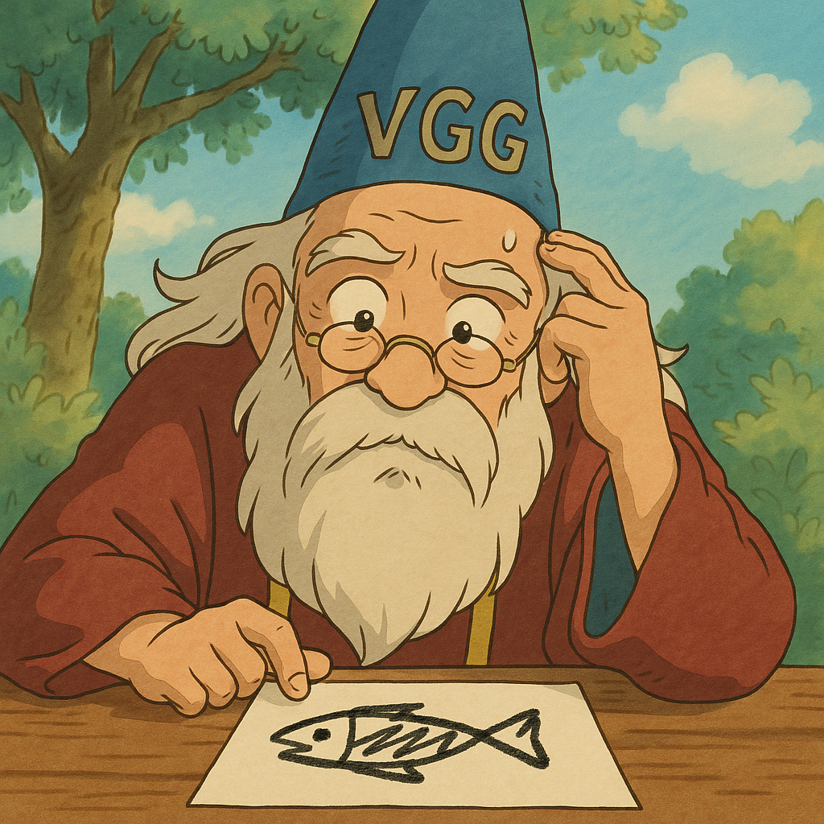
Pretrained: VGG16 Model
VGG16 is a deep convolutional neural network architecture developed by Oxford's Visual Geometry Group, known for its simplicity and use of stacked 3×3 convolutional layers.
Accuracy: 87.11%
Total params: 14,858,866 (56.68 MB)
Trainable params: 7,223,602 (27.56 MB)
Non-trainable params: 7,635,264 (29.13 MB)
While the paper "Meta Analysis of Deep Learning Models for Doodle Recognition" reports accuracies ranging from 70–84% across CNN-based models, our VGG16-based approach achieves 87.11%, outperforming all surveyed baselines.
Unlike most models in the paper trained from scratch, our method leverages transfer learning with ImageNet-pretrained weights, enabling better generalization on abstract doodles.
VGG being quite old and wise from pretraining, still puzzled with doodles!

Slide 23
Ablation Study
Experiment | Description | Trainable Params | Val. Accuracy
Baseline (Less classes) | Frozen Base | ~144K | ~68.30%
Finetuning | Unfrozen Block 5 | ~7.2M | ~87.11%
Baseline (all classes) | Frozen Base | ~157K | 46.88%
Finetuning | Unfrozen Block 5 | ~7.2M | 75.05%

Slide 24
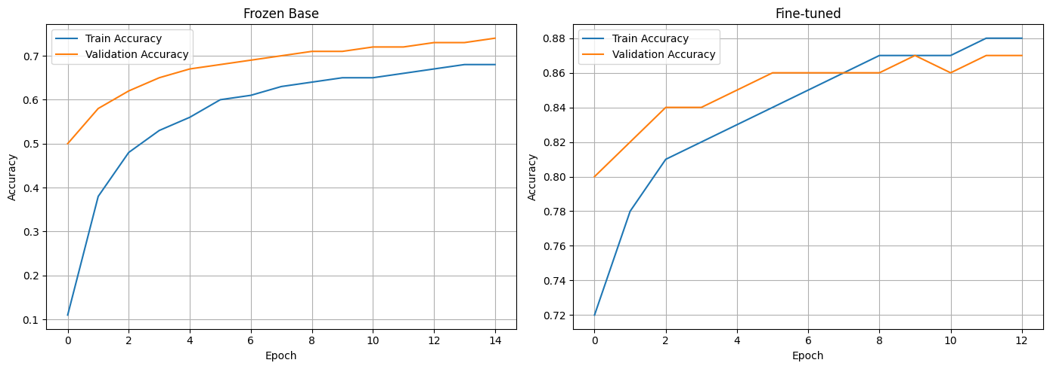
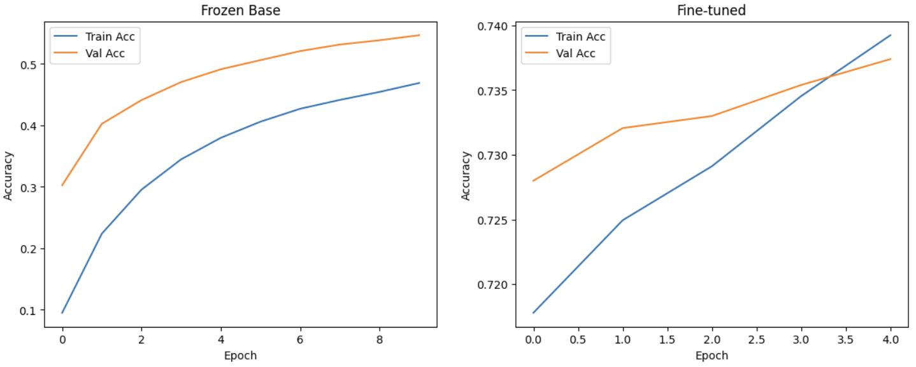
Results:

Slide 25
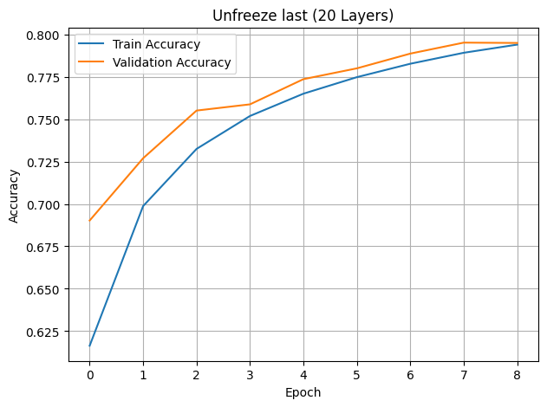
Pretrained: ResNet
ResNet (Residual Network) is a deep convolutional neural network architecture introduced by Microsoft Research in 2015, designed to enable the training of very deep networks using residual connections that mitigate the vanishing gradient problem.
Total Params: 23.89M
Accuracy: 79.49%
Although ResNet50 is parameter-heavy, its fast inference and 79.49% accuracy make it practical for server-side or high-end device deployment.
While the reference paper "Sketchformer: Transformer-based approach" found ResNet less effective on sketch data, our results show that with enough training samples and fine-tuning, ResNet50 can achieve strong performance (79%).
Experiment | Description | Trainable Params | Accuracy
ResNet | Frozen base – only top layers trained | ~537k | 48.32%
ResNet | Unfrozen last 20 layers for fine-tuning | ~9.4M | 79.49%

Slide 26


Pretrained: MobileNet
MobileNet was developed by researchers at Google in 2017 to provide a lightweight deep learning model optimized for mobile and embedded vision applications, using depthwise separable convolutions to significantly reduce computation and model size.
Accuracy: 87.22% Total params: 2,598,770 (9.91 MB)
Research paper comparison: Our model achieves 87.22% accuracy giving similar performance reported in the paper "Meta Analysis of Deep Learning Models for Doodle Recognition", where MobileNetV2 was evaluated on similar dataset.
With only 1.54M trainable parameters, the model remains highly efficient, demonstrating better generalization and convergence
Highly optimal for edge and resource-constrained devices due to its lightweight architecture, fast inference, and minimal trainable parameters

Slide 27
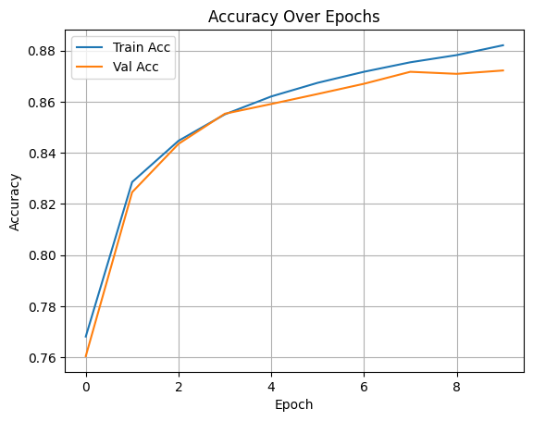
Ablation Study and Result
Experiment | Description | Trainable Parameters | Accuracy
MobileNetV2 (Lr: 0.0001) | MobileNetV2 with Adam optimizer using default learning rate (0.0001) | 340K | 75%
MobileNetV2 (Lr: 0.001) | MobileNetV2 with Adam optimizer using tuned learning rate and unfreezing some layers | 1.54M | 87.22%

Slide 28
Comparative Analysis of all Techniques
Technique | Inference Time (Avg) | Model Parameters | Accuracy | Remarks
LSTM | 25ms | 0.39M | 81.93 % | Fast for Strokes Data, but RNN is slow relatively
ConvLSTM | 110ms | 0.79M | 87.43 % | Higher Accuracy at tradeoff of larger Params and inference time
Transformer (Strokes) | 80ms | 0.62M | 76.29 % | Complex Model and higher params
Vision Transformer(Image) | 40ms | 7.93M | 79.96 % | Large Params | Limited Training resources affected results
CNN | 12ms | 0.23M | 87.20 % | Many Decision Parameters
Pretrained: InceptionV3 | 70ms | 0.28M to 15.2M | 86.30 % | Higher params leads to large inference time
Pretrained: VGG | 183ms | 14.8M | 88.10 % | Strong performance with moderate latency
Pretrained: Resnet | 7.76ms | 24.12M | ~79.49 % | Effective for high-performance tasks on capable hardware.
Pretrained: MobileNet | 16ms | 2.5M | 87.22 % | Good balance speed and efficiency
Hybrid - Strokes + Image | 23ms | 0.57M | 93.72 % | Best Approach: Optimal Params tradeoff with efficient Inference

Slide 29
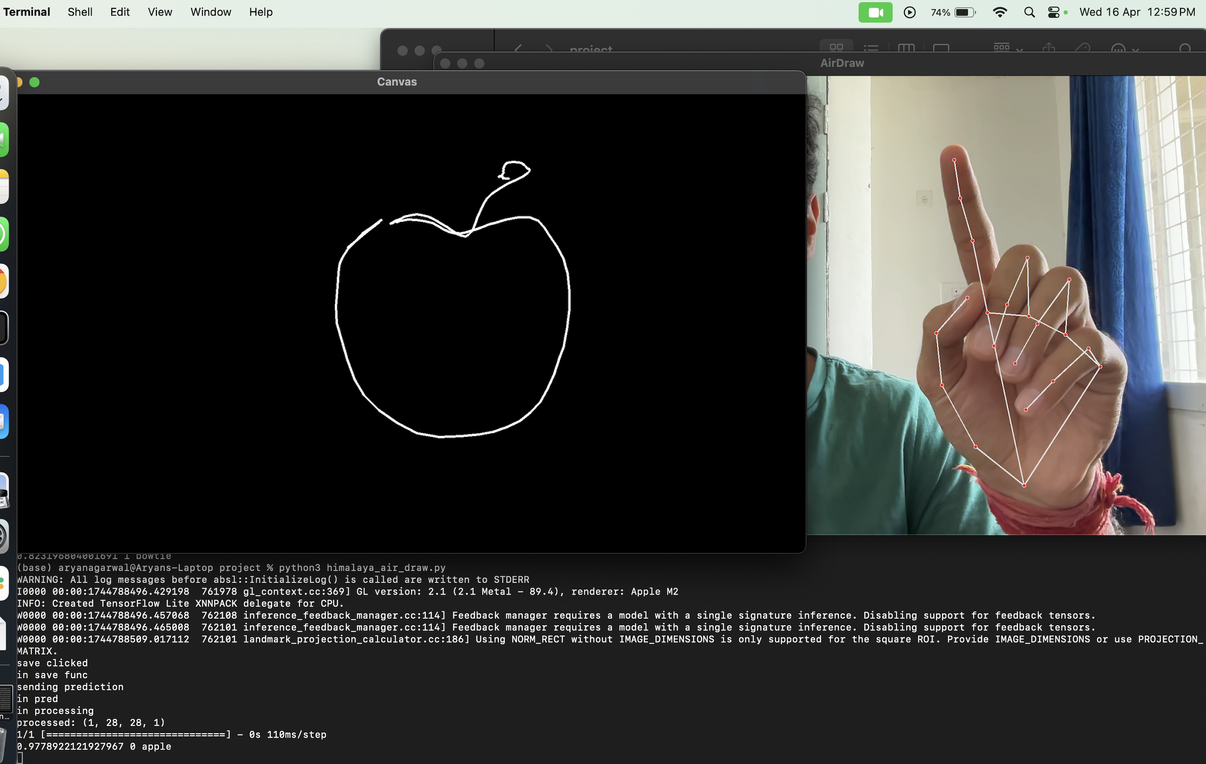
Let's go for a Demo at ~50–100ms inference per input!
At last, the Doodle SketchBoard of our DoodleVision!

Slide 30

Industry Use cases
Visual Search Engines: Users can draw objects (like fashion items or accessories), and the tool can predict what the object is, thereby improving shopping experiences.
Game Design: Game developers can sketch assets, and with model predictions enabling faster prototyping and asset creation.
Assistance for People with Disabilities: For people with disabilities who cannot type or speak, drawing might be a more accessible way to communicate. The tool could identify drawn objects and interpret commands or messages, improving interaction with digital devices.
Img src:https://www.analyticssteps.com/blogs/how-ai-improves-accessibility-people-disabilities

Slide 31

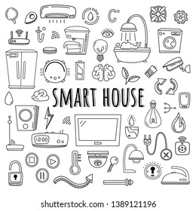
Industry Use cases (Contd.)
Design Tools: Tool for Engineering Drawings, Architecture Design, and Other design related tasks. It can also be used in Smart City Design
Educational Tools for Learning and Creativity: For example, Interactive Whiteboards
UI/UX Design Tools: Helps designers in making various UI/UX elements simply by drawing
Smart Home Devices: Integration with smart devices where users can draw a particular object (e.g., a lightbulb) to activate or control specific smart home features.
Img src: https://www.shutterstock.com%2Fimage-vector%2Fsmart-house-vector-set-elements-equipment

Slide 32

That's all from DoodleVision Folks! Thank you and have a Deeper- Learning ahead! :)

Slide 33
Team Contributions
All members will be working equally and together to learn all the components of the project and help fill in the missing knowledge gaps of others. But for listing the work division as asked, here is the work breakdown :-
Member Name | Roll Number | Tasks | Percentage
Aryan Agarwal | 241110012 | LSTM, ViT,ConvLSTM, Inference backend | 16.66%
Keshav Banka | 241110032 | InceptionV3 and Ablation Studies | 16.66%
Himalaya Kaushik | 241110029 | Hybrid Model, Transformer, Inference backend | 16.66%
Yuvraj Raghuvanshi | 241110084 | CNN Based Models and Ablation studies | 16.66%
Tsewang Namgail | 241110093 | VGG, Inference backend | 16.66%
Tsewang Chukey | 241110092 | ResNet, MobileNet and Ablation studies | 16.66%

Slide 34
References
Faseeh et al., Deep learning assisted real-time object recognition and depth estimation for enhancing emergency response in adaptive environment, Multimedia Tools and Applications, Springer, 2024.
Wahab et al., Design and implementation of real-time object detection system based on single-shoot detector and OpenCV, Indonesian J. of Electrical Engineering and Computer Science, 2021.
Parihar et al., SketchFormer: Transformer-based approach for sketch recognition using vector images, Multimedia Tools and Applications, Springer, 2021.
Zhao & Wang, Real-time object detection (YOLOv5), preprint/application note, 2021.
Zhong, Qian et al., Improved real-time object detection method based on YOLOv8: a refined approach, 2023 (preprint or conference).
Buchireddy et al., Hand-drawn doodle detection using machine learning, 2022 (local conference/journal).
Lee, Varghese, Vandierendonck, ROMA: Run-Time Object Detection To Maximize Real-Time Accuracy, IEEE TPDS, 2021.
Xu, Song, Yin, Song, Wang, Deep Self-Supervised Representation Learning for Free-Hand Sketch, IEEE TPAMI, 2023.
Gagandeep et al., Interactive System for Toddlers Using Doodle Recognition, 2022 (regional conference).
Shafiq & Gu, Deep Residual Learning for Image Recognition: A Survey, Artificial Intelligence Review, Springer, 2022.
Sethi, Duhan, Gupta, Jain, Meta Analysis of Deep Learning Models for Doodle Recognition, 2022 (institutional publication).
Xu, Joshi, Bresson, Multigraph Transformer for Free-Hand Sketch Recognition, CVPR, 2023.
Jain, Harisinghani, Gangar, Kambli, DoodSearch - OpenCV with Image Recognition, student project/paper, 2021.
Xu, Hospedales, Yin, Song, Xiang, Wang, Deep Learning for Free-Hand Sketch, IEEE TPAMI, 2018.
http://shutterstock.com/search/ai-goodbye
All images which are animated were generated with help of ChatGPT

